Slide 1
Lecture 12: Virtual Memory Optimizations
CS343 – Operating Systems
Branden Ghena – Spring 2022
Some slides borrowed from: Stephen Tarzia (Northwestern), Shivaram Venkataraman (Wisconsin), and UC Berkeley CS162

Slide 2
Today’s Goals
Explore optimizations to memory paging.
Insight into how virtual memory is used and what it looks like in today’s systems.
Review of the memory hierarchy and how the OS interacts with each level.
Introduce swapping as a mechanism for enabling more virtual memory than physical memory.
Explore several page replacement policies that control swapping.

Slide 3
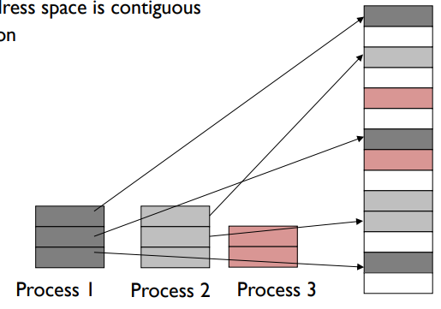
Memory paging
Divide memory into small, fixed-sized pages
Pages of virtual memory map to pages of physical memory
Like segments were mapped, but many more pages than segments
Processes and their sections can be mapped to any place in memory

Slide 4
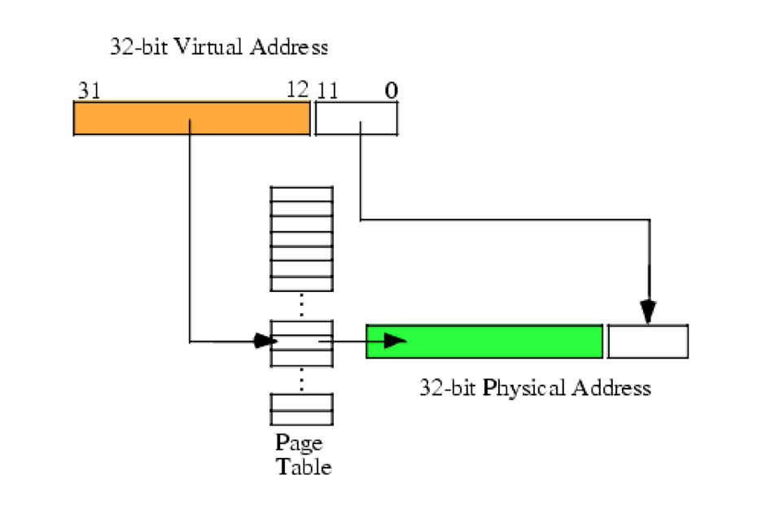
Page table translates virtual addresses to physical addresses
Use topmost bits of virtual address to select page table entry
One page table entry per each virtual page
Add address at page table entry to bottommost bits
Actually just concatenate the two
Just like segment tables, there will be a different page table for each process

Slide 5
Virtual Memory
(Process B Only!)
Process A
Physical Memory (RAM)
Shared
Process B
0
1
2
3
4
5
6
7
8
Process A
0
1
2
3
4
5
6
Process B
Process A
Process B Page Table
Process B
VPN | PPN | Valid?
0 | 2 | 1
1 | X | 0
2 | X | 0
3 | 6 | 1
4 | X | 0
5 | X | 0
6 | X | 0
7 | 4 | 1
8 | X | 0
Process B
CPU
Process A
Process B
Process A
Process B
Process B

Slide 6
Paging challenges
Page tables are slow to access
Page tables need to be stored in memory due to size
MMU only holds the base address of the page table and reads from it
Two memory loads per load!!!
Going to have to fix this…
Page tables require a lot of storage space
Mapping must exist for each virtual page, even if unused
Becomes a serious issue on 64-bit systems

Slide 7
Outline
…continued from last lecture
Paging improvements
Improving translation speed
Improving table storage size

Slide 8
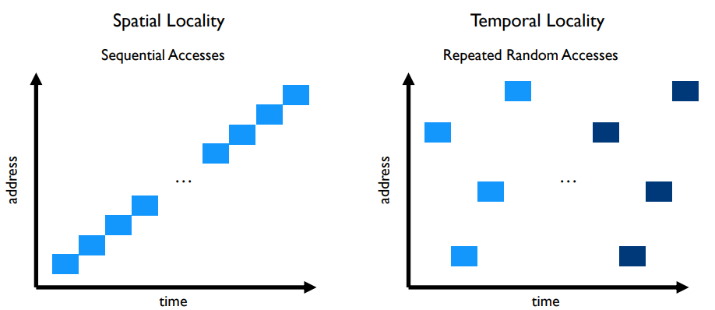
Caching can speed up page table access
How do we make page table access faster?
How do we make memory access faster?
Cache it!
Code and Stack have very high spatial locality

Slide 9
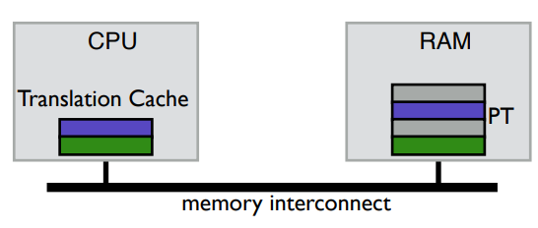
TLB caches page table entries
Translation Lookaside Buffer
Fully-associative cache (only compulsory misses)
Holds a subset of the page table (VPN->PPN mapping and permissions)
On a TLB miss, go check the real page table (done in hardware)

Slide 10
Address translation with TLB
Virtual Address
hardware
hardware or software
software
TLB
Lookup
TLB Miss
TLB Hit
Page Table
“Walk”
Protection
Check
Page not
in Mem
Page
in Mem
Access
Denied
Access
Permitted
Page Fault
(OS loads page)
Update
TLB
Protection
Fault
Physical
Address
Find in Disk
Find in Mem
SEGFAULT
Check cache

Slide 11
Context switches with a TLB
A process must only access its own page table entries in the TLB!
Otherwise, the mapping is wrong, and it accesses another process…
OS needs to manage the TLB
Option 1: Flush TLB on each context switch
Costly to lose recently cached translations
Option 2: Track with process each entry corresponds to
x86-64 Process Context Identifiers (12-bit -> 4096 different processes)
Extra state for the OS to manage if it has more processes than that

Slide 12
Software controlled TLBs
Some RISC CPUs have a software-managed TLB
TLB still used for translation, but a miss causes a fault for OS to handle
OS looks in page table for proper entry
OS evicts an existing entry from TLB
OS inserts correct entry into TLB
Special instruction allows OS to write to TLB
Hardware is simpler and OS has control over the TLB functionality
Can prefetch page table entries it thinks might be important
Can flush entries relevant to other processes
TLB misses take longer to complete, however

Slide 13
Outline
…continued from last lecture
Paging improvements
Improving translation speed
Improving table storage size

Slide 14
Paging disadvantages
Page tables are slow to access
Memory access for page table before any other memory access
TLB can speed this up considerably for common execution
Page tables require a lot of storage space
Mapping must exist for each virtual page, even if unused
Becomes a serious issue on 64-bit systems

Slide 15
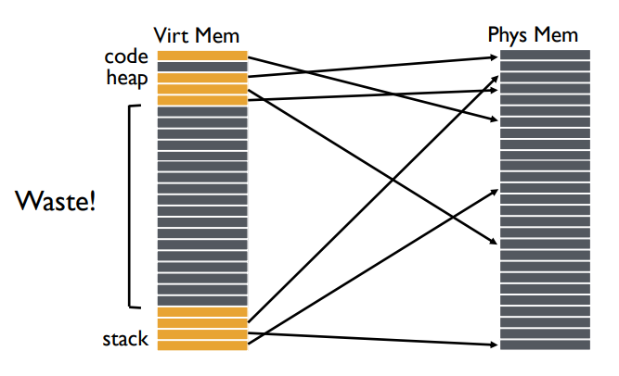
Why do page tables take so much storage space?
For every virtual page, there must exist an entry in the page table
Even though most virtual addresses aren’t used!
32-bit address space with 4 kB pages -> 1 million entries
At least 8 MB of storage
64-bit address space would require 36 exabytes of page table storage…

Slide 16
Create multiple page tables, each with useful mappings only
How do we eliminate extraneous entries from the page tables?
Virtual Page Number | Valid? | Physical Page Number
0 | 1 | 2
1 | 1 | 3
2 | 0
3 | 0
4 | 0
5 | 1 | 7
6 | 0
7 | 0

Slide 17
Create multiple page tables, each with useful mappings only
Collect groups of page table entries (call them “page table entry pages”?)
Virtual Page Number | Valid? | Physical Page Number
0 | 1 | 2
1 | 1 | 3
2 | 0
3 | 0
4 | 0
5 | 1 | 7
6 | 0
7 | 0

Slide 18
Create multiple page tables, each with useful mappings only
Collect groups of page table entries
Only keep groups that have valid mappings in them
Virtual Page Number | Valid? | Physical Page Number
0 | 1 | 2
1 | 1 | 3
4 | 0
5 | 1 | 7

Slide 19
Create multiple page tables, each with useful mappings only
Collect groups of page table entries
Only keep groups that have valid mappings in them
Remaining groups are now separate tables
Virtual Page Number | Valid? | Physical Page Number
0 | 1 | 2
1 | 1 | 3
Virtual Page Number | Valid? | Physical Page Number
4 | 0
5 | 1 | 7

Slide 20
Create multiple page tables, each with useful mappings only
Collect groups of page table entries
Only keep groups that have valid mappings in them
Remaining groups are now separate tables
Create a directory of page tables to collect existing page tables
Virtual Page Number | Valid? | Physical Page Number
0 | 1 | 2
1 | 1 | 3
Virtual Page Number | Valid? | Physical Page Number
4 | 0
5 | 1 | 7
Virtual Page Number Range | Valid? | Page Table Address
0-1 | 1
2-3 | 0
4-5 | 1
6-7 | 0

Slide 21
Multilevel page tables
Virtual Address
31
22
21
12
11
0
p1 p2 offset
10-bit
L1 index
10-bit
L2 index
Root of the Current
L1 Page Table (Hardware register)
offset
Physical Memory
p2
p1
Valid page table
Level 1
Page Table
(Directory)
Invalid page table
Valid page
Level 2
Page Tables
Invalid page
Unused RAM
Valid data in RAM
Data Pages

Slide 22
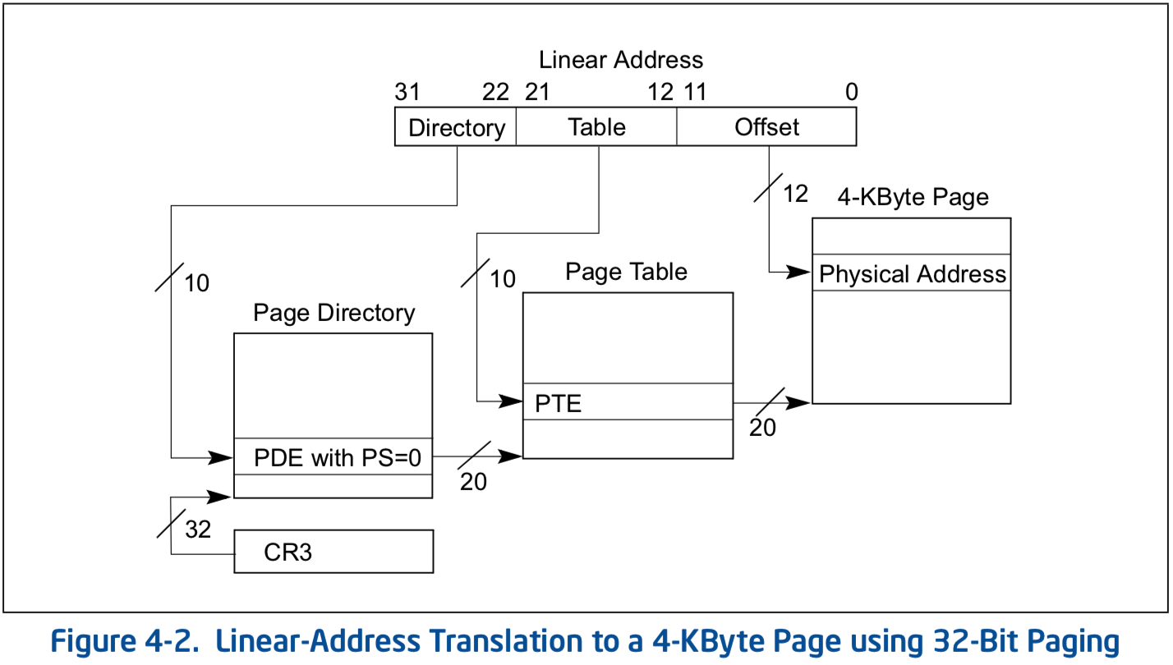
Multilevel page table logistics
Virtual address is broken down into three or more parts
Highest bits index into highest-level page table
A missing entry at any level triggers a page fault
Size of tables in memory proportional to number of pages of virtual memory used
Small processes can have proportionally small page tables

Slide 23
Multilevel page tables can keep nesting
Even page table directory is often sparse, so break it up too
x86-64
Four levels of page table
48-bit addresses (256 TB RAM ought to be enough for everyone right?)
9 bits
9 bits
9 bits
9 bits
12 bits
48-bit Virtual
Address:
Virtual
P1 index
Virtual
P2 index
Virtual
P3 index
Virtual
P4 index
Offset
PageTablePtr
8 bytes
4096-byte pages (12 bit offset) Page tables also 4k bytes (pageable)
Physical
Address:
(40-50 bits)
Physical Page #
12bit Offset

Slide 24
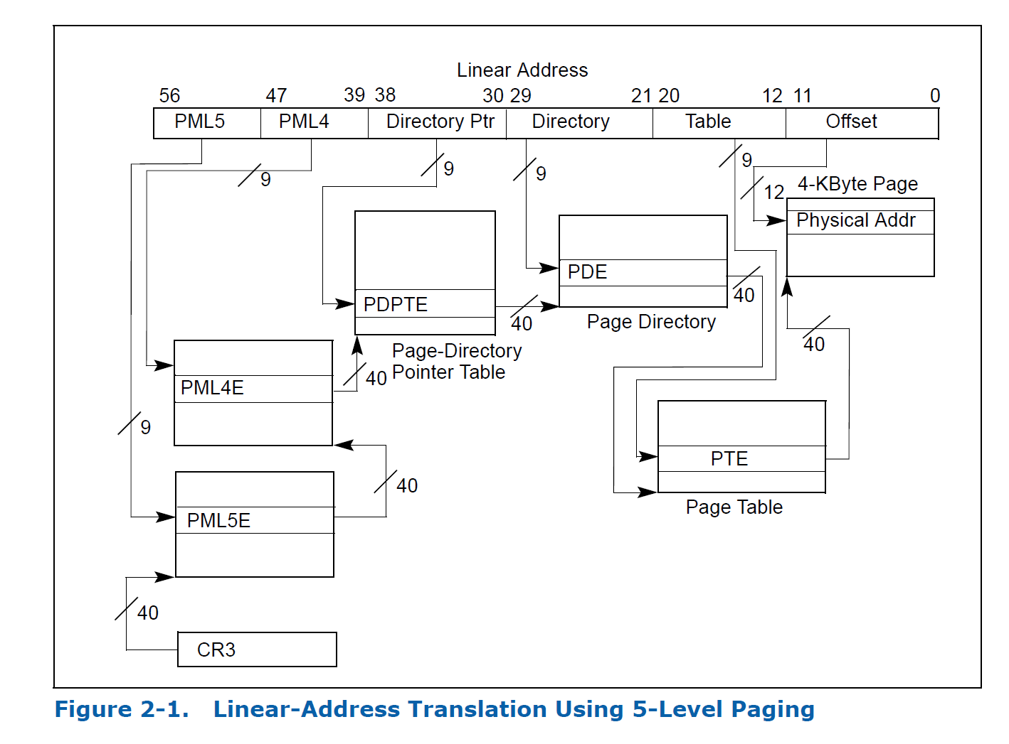
Intel Ice Lake (2019): 5 layers!!

Slide 25
Check your understanding – multilevel page table
How many memory loads per read are there now?

Slide 26
Check your understanding – multilevel page table
How many memory loads per read are there now?
6
As in each memory access takes six times as long
TLB is extremely important

Slide 27
Additional optimization: large pages
Always using large pages results in wasted memory
Example: 1 MB page where only 1 KB is used
Always using small pages results in unnecessary page table entries
Example: 250 entries in a row to represent 1 MB of memory
Can we mix in larger pages opportunistically?
Small pages normally
Large pages occasionally
Huge pages rarely

Slide 28
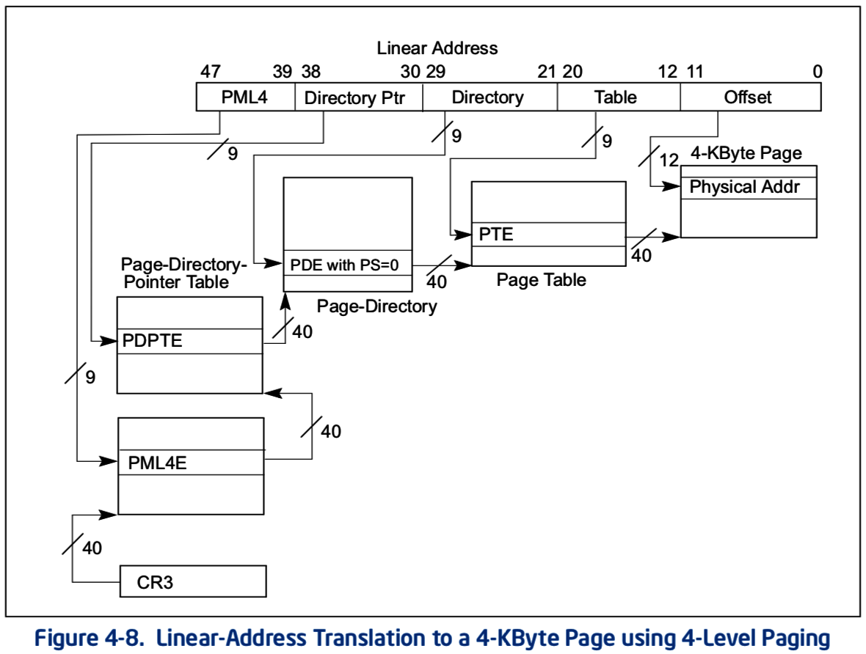
x86-64 allows multiple-sized pages: 4 KB
Normal x86-64 paging

Slide 29
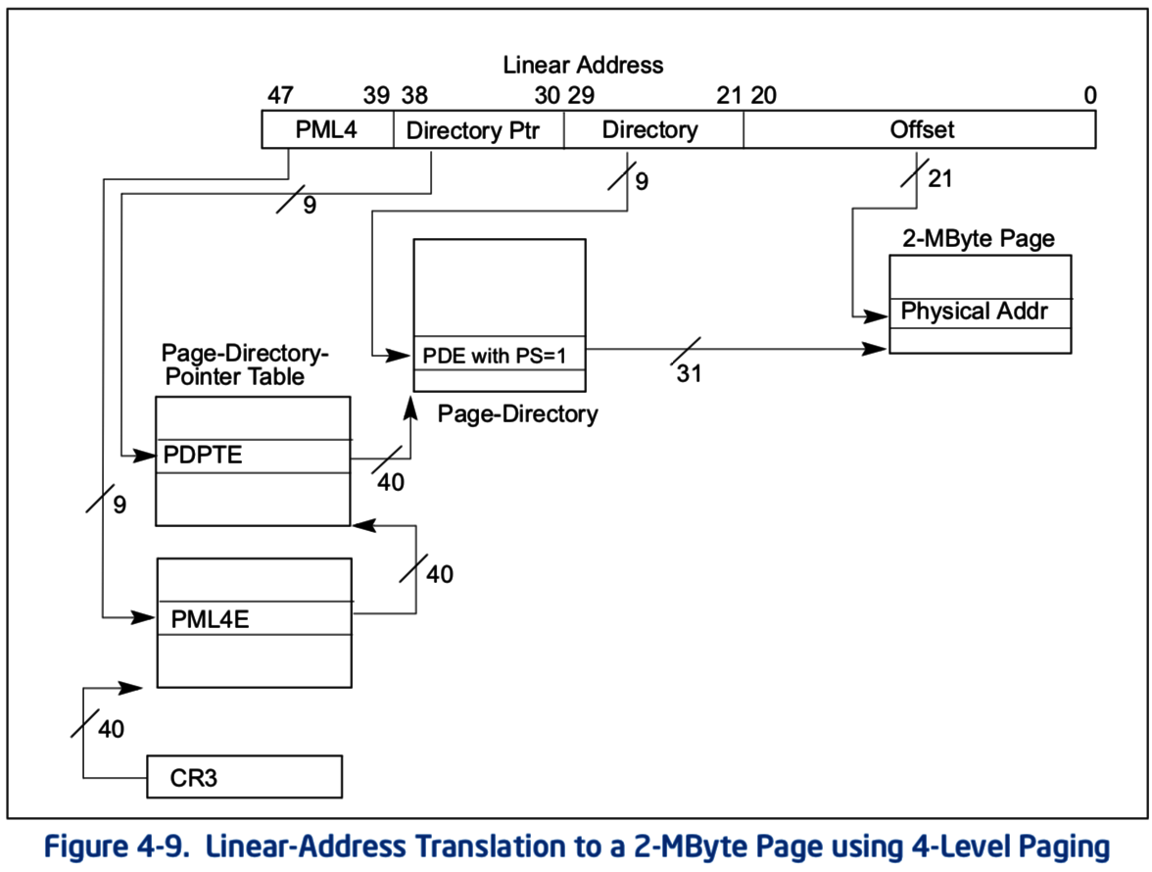
x86-64 allows multiple-sized pages: 2 MB
Page Size bit triggers walk to skip next table and go straight to 2 MB page in memory
Remaining address bits are used as offset into larger page

Slide 30
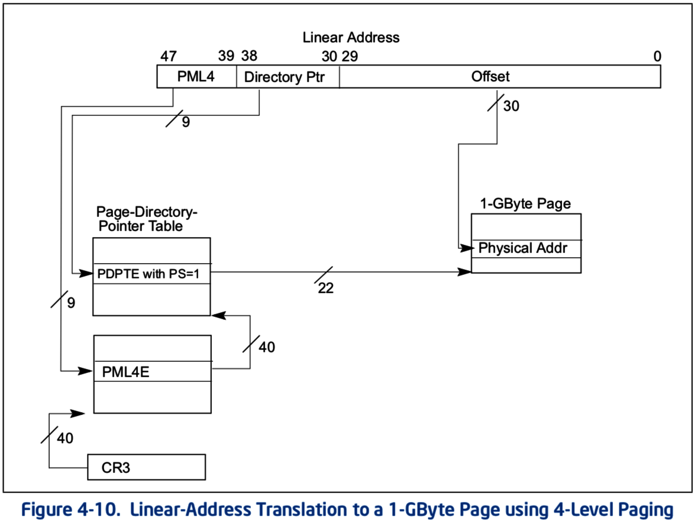
x86-64 allows multiple-sized pages: 1 GB
Can also skip straight to 1 GB pages
With a bit of extra hardware, TLB can hold large page entries
Occupies a single TLB entry for 1 GB of data (250000 normal entries)

Slide 31
Other data structures for paging
If hardware handles TLB misses
Need a regular structure it can “walk” to find page table entry
x86-64 needs to use multilevel page tables
If software handles TLB misses
OS can use whatever data structure it pleases
Example: inverted page tables
Only store entries for virtual pages with valid physical mappings
Use hash of VPN+PCID to find the entry you need

Slide 32
Break + Question
If every page of virtual memory was used, would a multi-level page table take more or less space than a “flat” page table?
How often is every page of virtual memory used?

Slide 33
Break + Question
If every page of virtual memory was used, would a multi-level page table take more or less space than a “flat” page table?
More! Still need an entry for every “used” page
Now would have to add tree structure as well
How often is every page of virtual memory used?
Never! That would be 18 exabytes of storage in one process
For refence: ~44000 exabytes is all of human digital storage (2022)

Slide 34
Outline
Paging in modern OS
Memory Hierarchy
Swapping
Page Replacement Policies

Slide 35
OS management of processes with paging
When loading a process
OS places actual memory into physical pages in RAM
OS creates page table for the process
OS decides access permissions to different pages
OS connects to shared libraries already in RAM
When a context switch occurs
OS changes which page table is in use (%CR3 register in x86)
When a fault occurs
OS decides how to handle it. (Invalid access or missing page?)

Slide 36
Page faults enable lazy allocation and lazy loading
Paging is not just translation and overflow
Paging provides an opportunity to be lazy about loading requested data
Trick: don’t load data upfront, do it later when it’s first needed!
This is an important performance optimization, reducing program start time

Slide 37
Lazy loading in practice
If a process requests a huge chunk of memory, maybe it will not use all that memory immediately (or ever!).
Programmers and compilers are sometimes greedy in their requests
We can virtually allocate memory, but mark most of the pages “not present”
Let the CPU raise an exception when the memory is really used
Then really allocate the demanded page
Lazy allocation minimizes latency of fulfilling the request and it prevents OS from allocating memory that will not be used.

Slide 38
Extra features of lazy loading
Lazy loading also works for large code binaries
Delay loading a page of instructions until it’s needed
OS must also write zeros to newly assigned physical frames
Program does not necessarily expect the new memory to contain zeros,
But we clear the memory for security, so that other process’ data is not leaked.
OS can keep one read-only physical page filled with zeros and just give a reference to this at first.
After the first page fault (due to writing a read-only page), allocate a real page.

Slide 39
Lazy allocation via copy-on-write with Fork
Recall that fork + exec is the only way to create a child process in unix
Fork clones the entire process, including all virtual memory
This can be very slow and inefficient, especially if the memory will just be overwritten by a call to exec.

Slide 40
Lazy allocation via copy-on-write with Fork
Copy on write is a performance optimization:
Don’t copy the parent’s pages, share them
Make the child process’ page table point to the parent’s physical pages
Mark all the pages as “read only” in the PTEs (temporarily)
If parent or child writes to a shared page, a page fault exception will occur
OS handles the page fault by:
Copying parent’s page to the child & marking both copies as writeable
When the faulting process is resumed, it retries the memory write.

Slide 41
Virtual memory in practice
On Linux, the pmap command shows a process’ VM mapping.
We see:
OS tracks which file code is loaded from, so it can be lazily loaded
The main process binary and libraries are lazy loaded, not fully in memory
Libraries have read-only sections that can be shared with other processes
cat /proc/<pid>/smaps shows even more detail
References:
https://unix.stackexchange.com/a/116332
https://www.akkadia.org/drepper/dsohowto.pdf

Slide 42
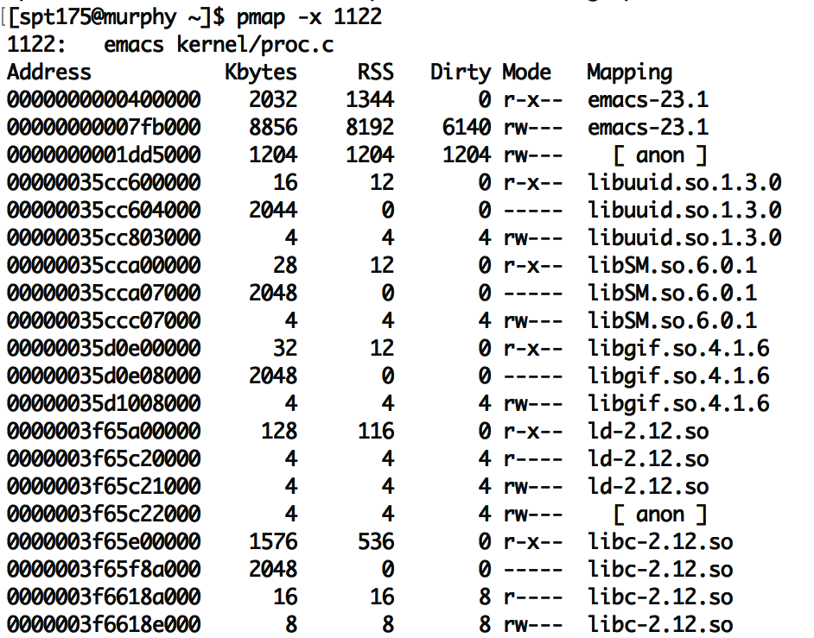
pmap on emacs
“Mapping” shows source of the section, more code can be loaded from here later.
“anon” are regular program data, requested by sbrk or mmap. (In other words, heap data.)
Each library has several sections:
“r-x--” for code can be shared
“r----” for constants
“rw---” for global data
“-----” for guard pages:
(not mapped to anything, just reserved to generate page faults)
RSS means resident in physical mem.
Dirty pages have been written and therefore cannot be shared with others

Slide 43
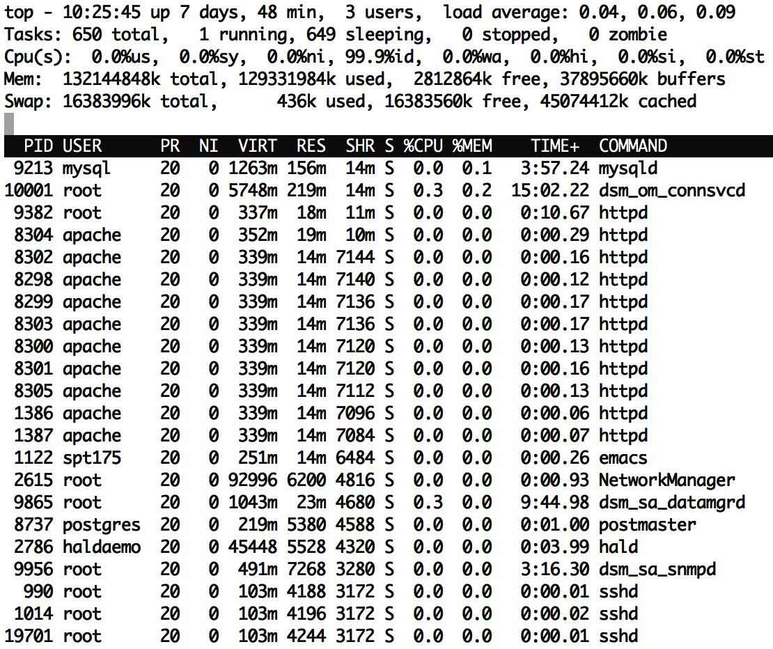
top has a column showing shared memory
The duplicate processes are using a lot of shared memory:
~50% of resident memory for httpd is shared ~75% of resident memory for sshd is shared
Even if there is just one instance of emacs running, it may share many libraries with other running programs.
Total virtual memory is ~10x larger than resident memory
Processes only use a small fraction of their VM!
Due to sharing and lazy loading.

Slide 44
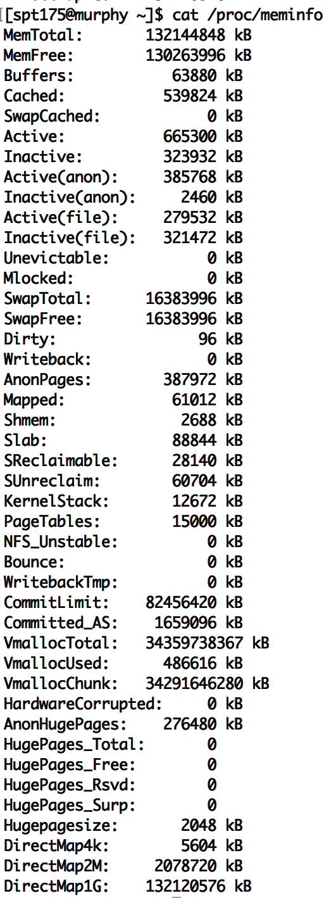
To see virtual memory info on Linux
cat /proc/meminfo
vmstat
top
(resident)

Slide 45
Requesting memory from the OS – brk()
System call to change data segment size (the program “break”)
Either set a new virtual address pointer for top of data segment
Or increment the size of the data segment by N bytes
These are the old system calls to dynamically change program memory
How malloc creates space
“sbrk() and brk() are considered legacy even by 1997 standards”
Removed from POSIX in 2001
Still exists in some form in lots of OSes (including Nautilus)

Slide 46
Modern requesting memory from the OS – mmap()
Map (or unmap) files or devices into memory
Given a file, places the file in the process’s virtual address space
Process can request an address to place it at, which OS might follow
Given flag MAP_ANONYMOUS, creates empty memory
Initialized to zero and accessible from process
Malloc implementation uses this
Many other options
Create huge page, create memory for a stack, shared memory

Slide 47
Break + Consideration
Why use mmap() to put a file in your address space, when you could just read()/write() it instead?

Slide 48
Break + Consideration
Why use mmap() to put a file in your address space, when you could just read()/write() it instead?
Speed! No longer need to make system calls for each file access
A downside: now you need to handle file interactions yourself
Track offset for reading and writing
Make sure you don’t go past the end of the file

Slide 49
Outline
Paging in modern OS
Memory Hierarchy
Swapping
Page Replacement Policies

Slide 50
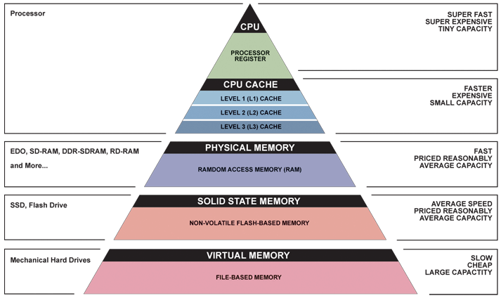
Memory Hierarchy

Slide 51
The OS view on registers
Illusion: separate set for each process
Reality: separate set for each core (or each thread in a core)
OS needs to save and update registers whenever the currently running process changes
Process and hardware handle moving memory into registers

Slide 52
The OS view on caches
Mostly ignore them, handled by the hardware automatically
Occasionally might need to clear them for security purposes
Addresses in the caches are either entirely physical addresses
Or are virtually indexed, physically tagged
Cache lookup and TLB lookup happen in parallel
TLB result is used as Tag for cache to determine if there was a hit

Slide 53
The OS view on memory
Managed through virtual memory translation
Paging (or Segmentation) that we talked about last time
OS chooses which portions of processes go in RAM
Other portions of memory get “swapped” to disk
Writeable memory regions (stack, heap, global data) must be preserved
Read-only memory regions (code) can be reloaded from original location

Slide 54
The OS view on disk
Non-volatile memory store
Everything else on the system disappears when power is removed (and cannot be trusted across reboots)
Backing store for lots of information
Boot information: via “Master Boot Record” on disk
Filesystem, which the OS manages access to through system calls
Swap space, which the OS moves extra pages in and out of
Disk is significantly bigger than RAM, so this will work
Disk is a device that the OS manages and reads in “blocks”
Compare to memory, which is directly addressed by processes

Slide 55
Traditional hard disk drives (HDDs) use magnetic regions

Slide 56
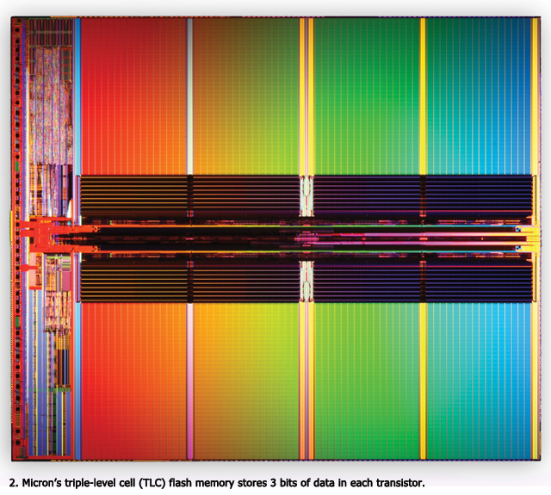
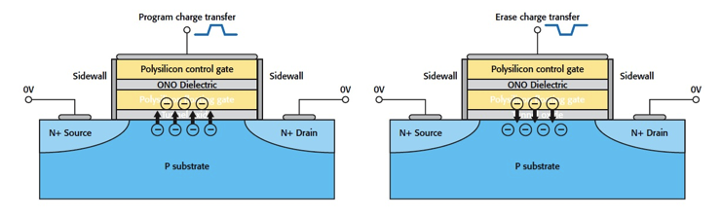
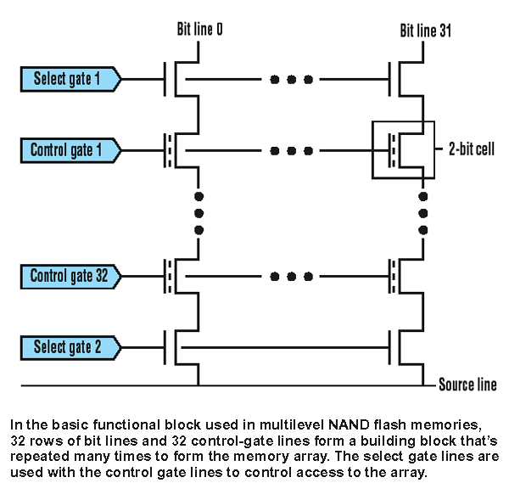
Solid state drives (SSDs) use flash memory
Still non-volatile
Significantly faster
0.1 ms to access (10 ms for disk)
More limited lifetime than disk
Limited writes
NMOS transistor with an additional conductor between gate and source/drain which “traps” electrons. The presence/absence is a 1 or 0

Slide 57
Outline
Paging in modern OS
Memory Hierarchy
Swapping
Page Replacement Policies

Slide 58
Motivation for swapping
Processes should be independent of the amount of physical memory
Should be correct, even if not performant
OS goal: support processes when not enough physical memory
Multiple processes combining to more than physical memory
Single process with very large address space
Video games: Red Dead Redemption 2 – 150 GB
Large-scale data processing: Compiling Android – 16 GB
OS provides illusion of more physical memory by using disk

Slide 59
Locality of reference
If disk is involved with memory, won’t this be ridiculously slow?
Leverage locality of reference within process
Spatial: memory addresses near referenced address likely to be next
Temporal: referenced addresses likely to be referenced again
Processes spend majority of time in a small portion of code
Estimate: 90% of time spent in 10% of code (loops)
Implication
Process only uses small amount of address space at any moment
Only small amount of address space needs to be in physical memory
RAM acts as a sort of cache for program memory

Slide 60
How swapping works
OS moves unreferenced pages to disk
Processes can still run when not all pages are in physical memory
OS and hardware cooperate to make memory available when needed
Same behavior as if all of address space always was in memory
Except in terms of time, but processes don’t know about time…
Requirements
OS needs mechanism to identify location of address space pages on disk and move them into RAM when necessary
OS needs policy to determine which pages go in RAM or disk

Slide 61
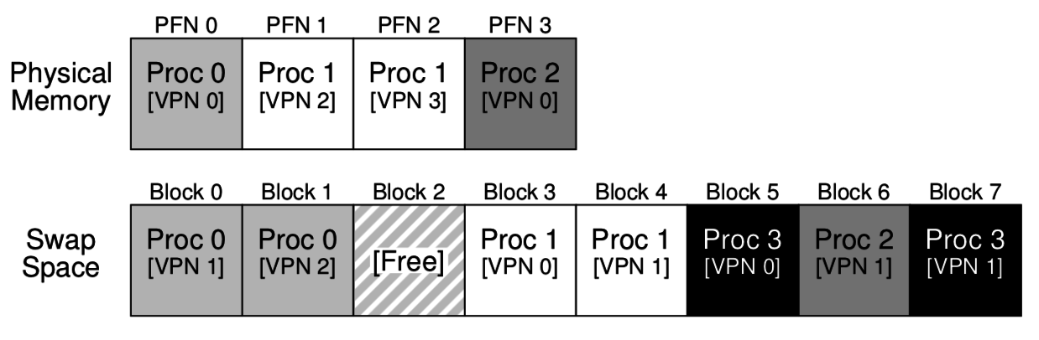
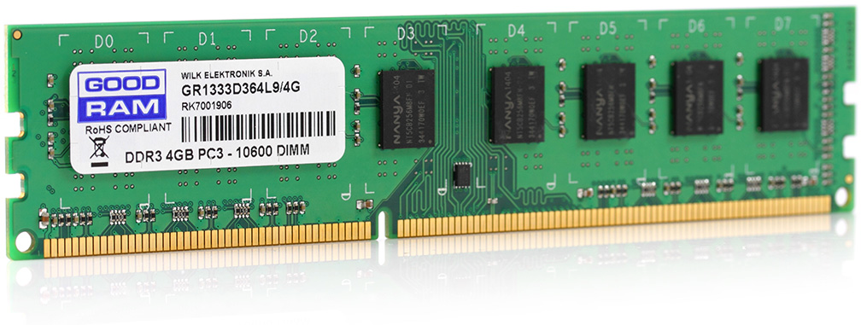
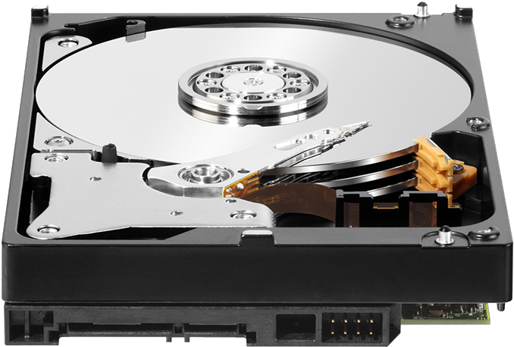
Combination of swapping and paging
Processes have memory pages, which are distributed among RAM and Disk
Example:
Processes 0, 1, and 2 are partially in RAM
Process 3 is entirely in “swap space” on disk

Slide 62
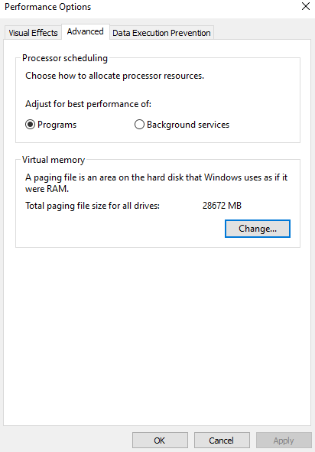
Paging on Windows
Windows lets you see and even set the size of swap space on disk

Slide 63
Mechanisms to support swapping
Each page in virtual address space lives in a location
Physical memory
Disk
Nowhere
Extend page tables with an extra bit – present
Physical Page Number, Permissions, Valid, Present
Page in memory, valid and present
Page on disk, valid but not present
Page Table Entry points to block on disk instead!
Trap to OS on reference
Invalid page, not valid and not present OR bad permissions
Trap to OS on reference

Slide 64
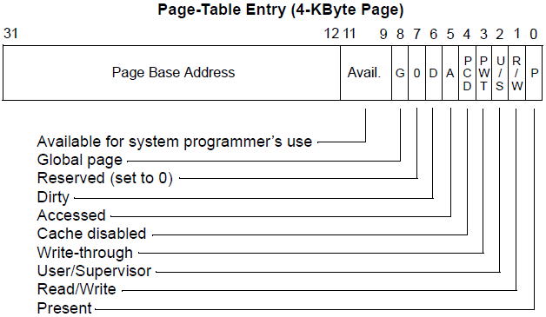
Other bits in a page table entry
Page Base Address can be reused to hold disk block
Dirty bit
Whether page has been modified
If page needs to be swapped out, only preserve if modified

Slide 65
Steps to a memory access with swapping
Hardware checks TLB for virtual address
If Hit, address translation complete AND page in physical memory
Hardware (or OS) walks page tables
If valid and present, then page in physical memory
Trap into OS
If invalid or bad permissions, fault process (segmentation fault)
If valid but not present
If memory is full, select a victim page in memory to replace
If modified (dirty), write to disk
Invalidate TLB entry for that page
OS reads referenced page from disk into memory
Page table is updated, present bit is set
Resume process execution (could be really complicated on CISC machines)

Slide 66
Types of page faults
Minor/soft: Page is loaded in memory, but PTE is not configured:
Memory could be a shared library already in memory from another process.
OS could be tracking accesses to this page. (hardware without a dirty bit)
Response: update the PTE.
Major/hard: A disk access will be needed:
Anonymous page (process data) may have been swapped out.
Lazy-loading program executable.
Response: load the page from disk
Invalid: User program misbehaved:
Dereference null or invalid pointer.
Write to page that is read-only.
Execute code on a page that is not executable (for security).
Response: terminate the process.

Slide 67
Policies to determine swapping evictions
Goal: minimize the number of page faults
Page faults need to read/write from disk and are very slow
So the OS can take plenty of time to make a good decision
OS has two decisions
Page Selection
When should a page be brought into memory?
Page Replacement
When should a page be swapped into disk?
Which page should be swapped out of physical memory?

Slide 68
When do we load in pages? (page selection)
Demand paging: Load page only when page fault occurs
Intuition: Wait until page must absolutely be in memory
When process starts: No pages are loaded in memory
Problems: Pay cost of page fault for every newly accessed page
Pre-paging (prefetching): Load page before referenced
OS predicts future accesses and brings pages into memory early
Works well for some access patterns (e.g., sequential)
Hints: Combine above with user-supplied hints about page references
User specifies: may need page in future, don’t need this page anymore, or sequential access pattern, ...
Example: madvise() in POSIX – “give advice about use of memory”

Slide 69
When do we swap out pages? (page replacement)
Demand swapping: whenever the page fault actually occurs
Simplest method
Swap actually occurs asynchronously
Start the disk I/O and block the process that faulted
Background swapping: preemptively when RAM is getting full
Background service in kernel periodically runs (kswapd)
If number of free physical pages < “low water mark”, evict a bunch
Writing many pages to disk in one operation is way more efficient

Slide 70
Thrashing
Thrashing: when swapping happens frequently
Policy could be bad (working set keeps getting swapped to disk)
More likely RAM is too small
Frequent swapping slows down the whole computer to a crawl
Constantly waiting on disk I/O
Solution for thrashing
Kill processes until it stops (relieves memory pressure)
Install more RAM in the computer

Slide 71
Outline
Paging in modern OS
Memory Hierarchy
Swapping
Page Replacement Policies

Slide 72
Which page should be evicted?
Page replacement policy determines page to evict
Very similar process as cache eviction or TLB eviction
Misses are expensive, so make sure you evict the right page
Page faults are extremely long, so a sophisticated policy is possible

Slide 73
Optimal page replacement policy
Optimal page replacement
Evict page that will be accessed furthest in the future
Advantages
Guaranteed to minimize the number of page faults
Disadvantages
Requires the OS to predict the future and therefore cannot exist
Performance upper bound
This is the best anything can do, so it is useful to compare against
Still has misses due to cold-start and capacity

Slide 74
First-In-First-Out replacement policy
FIFO replacement
Evict page that has been in memory the longest
Advantages
Fair as all pages have equal residency
Easy to implement
Disadvantages
Some pages of memory are always needed (stack)
Memory doesn’t really need “fairness” like processes did

Slide 75
Least Recently Used replacement policy
LRU replacement
Replace page not accessed for longest time
Using the past to predict the future (temporal locality)
Advantages
With locality, LRU approximates Optimal
Disadvantages
Harder to implement as we need to track when pages are accessed
Cyclical patterns can make LRU fail (bigger concern for cache than RAM)

Slide 76
Check your understanding – simple replacement policies
Page Requested
Optimal
FIFO
LRU
D
D
B
B
A
C
B
D
B
D
D
D
B
B
A
C
B
D
B
D
D
D
B
B
A
C
B
D
B
D
time

Slide 77
Check your understanding – simple replacement policies
Page Requested
Optimal
FIFO
LRU
D | D |  |  | Miss
D | D |  |  | Hit
B | D | B |  | Miss
B | D | B |  | Hit
A | D | B | A | Miss
C
B
D
B
D
D
D
B
B
A
C
B
D
B
D
D
D
B
B
A
C
B
D
B
D
time

Slide 78
Check your understanding – simple replacement policies
Page Requested
Optimal
FIFO
LRU
D | D |  |  | Miss
D | D |  |  | Hit
B | D | B |  | Miss
B | D | B |  | Hit
A | D | B | A | Miss
C
B
D
B
D
D | D |  |  | Miss
D | D |  |  | Hit
B | D | B |  | Miss
B | D | B |  | Hit
A | D | B | A | Miss
C
B
D
B
D
D | D |  |  | Miss
D | D |  |  | Hit
B | D | B |  | Miss
B | D | B |  | Hit
A | D | B | A | Miss
C
B
D
B
D
time

Slide 79
Check your understanding – simple replacement policies
Page Requested
Optimal
FIFO
LRU
D | D |  |  | Miss
D | D |  |  | Hit
B | D | B |  | Miss
B | D | B |  | Hit
A | D | B | A | Miss
C | D | B | C | Miss
B | D | B | C | Hit
D | D | B | C | Hit
B | D | B | C | Hit
D | D | B | C | Hit
D | D |  |  | Miss
D | D |  |  | Hit
B | D | B |  | Miss
B | D | B |  | Hit
A | D | B | A | Miss
C
B
D
B
D
D | D |  |  | Miss
D | D |  |  | Hit
B | D | B |  | Miss
B | D | B |  | Hit
A | D | B | A | Miss
C
B
D
B
D
time

Slide 80
Check your understanding – simple replacement policies
Page Requested
Optimal
FIFO
LRU
D | D |  |  | Miss
D | D |  |  | Hit
B | D | B |  | Miss
B | D | B |  | Hit
A | D | B | A | Miss
C | D | B | C | Miss
B | D | B | C | Hit
D | D | B | C | Hit
B | D | B | C | Hit
D | D | B | C | Hit
D | D |  |  | Miss
D | D |  |  | Hit
B | D | B |  | Miss
B | D | B |  | Hit
A | D | B | A | Miss
C | C | B | A | Miss
B | C | B | A | Hit
D | C | D | A | Miss
B | C | D | B | Miss
D | C | D | B | Hit
D | D |  |  | Miss
D | D |  |  | Hit
B | D | B |  | Miss
B | D | B |  | Hit
A | D | B | A | Miss
C
B
D
B
D
time

Slide 81
Check your understanding – simple replacement policies
Page Requested
Optimal
FIFO
LRU
D | D |  |  | Miss
D | D |  |  | Hit
B | D | B |  | Miss
B | D | B |  | Hit
A | D | B | A | Miss
C | D | B | C | Miss
B | D | B | C | Hit
D | D | B | C | Hit
B | D | B | C | Hit
D | D | B | C | Hit
D | D |  |  | Miss
D | D |  |  | Hit
B | D | B |  | Miss
B | D | B |  | Hit
A | D | B | A | Miss
C | C | B | A | Miss
B | C | B | A | Hit
D | C | D | A | Miss
B | C | D | B | Miss
D | C | D | B | Hit
D | D |  |  | Miss
D | D |  |  | Hit
B | D | B |  | Miss
B | D | B |  | Hit
A | D | B | A | Miss
C | C | B | A | Miss
B | C | B | A | Hit
D | C | B | D | Miss
B | C | B | D | Hit
D | C | B | D | Hit
time

Slide 82
Check your understanding – simple replacement policies
Page Requested
Optimal
FIFO
LRU
D | D |  |  | Miss
D | D |  |  | Hit
B | D | B |  | Miss
B | D | B |  | Hit
A | D | B | A | Miss
C | D | B | C | Miss
B | D | B | C | Hit
D | D | B | C | Hit
B | D | B | C | Hit
D | D | B | C | Hit
D | D |  |  | Miss
D | D |  |  | Hit
B | D | B |  | Miss
B | D | B |  | Hit
A | D | B | A | Miss
C | C | B | A | Miss
B | C | B | A | Hit
D | C | D | A | Miss
B | C | D | B | Miss
D | C | D | B | Hit
D | D |  |  | Miss
D | D |  |  | Hit
B | D | B |  | Miss
B | D | B |  | Hit
A | D | B | A | Miss
C | C | B | A | Miss
B | C | B | A | Hit
D | C | B | D | Miss
B | C | B | D | Hit
D | C | B | D | Hit
time
Miss rate = 40%
Miss rate = 60%
Miss rate = 50%

Slide 83
Implementing LRU
Implementing perfect LRU is difficult in practice
Software perfect LRU
OS maintains an ordered list of physical pages by reference time
When page is referenced: move to end of list
When swap is needed: evict front of list
Tradeoff: slow on memory reference, fast on replacement (unacceptable)
Hardware perfect LRU
Associate a timestamp with each physical page
When page is referenced: hardware updates timestamp for page
When swap is needed: OS searches through all pages for oldest
Tradeoff: fast on memory reference, extremely slow on replacement and needs special hardware

Slide 84
Clock algorithm
LRU approximates Optimal anyways, so approximate a little more
Goal: find an old page, not necessarily the oldest page
Clock algorithm
One “accessed” bit added to each page
When page is referenced: accessed bit is set to one (hardware)
When swap is needed:
Cycle through pages looking for one with accessed bit zero
Update accessed bit to zero after checking a page
Continue from where you left off when next swap is needed
Essentially looks for page that hasn’t been referenced this “cycle”

Slide 85
Clock algorithm example
(Page Name, Accessed Bit)
Initial setup
6 pages total fit in memory
Accessed starts as zero
“clock hand” points at first page
A, 0
B, 0
C, 0
D, 0
E, 0
F, 0

Slide 86
Clock algorithm example
(Page Name, Accessed Bit)
After running a little while
Pages A, B, E are accessed
A, 1
B, 1
C, 0
D, 0
E, 1
F, 0

Slide 87
Clock algorithm example
(Page Name, Accessed Bit)
OS needs to swap pages
Algorithm starts
A is recently accessed
A, 1
B, 1
C, 0
D, 0
E, 1
F, 0

Slide 88
Clock algorithm example
(Page Name, Accessed Bit)
OS needs to swap pages
Algorithm starts
A is recently accessed
B is recently accessed
A, 0
B, 1
C, 0
D, 0
E, 1
F, 0

Slide 89
Clock algorithm example
(Page Name, Accessed Bit)
OS needs to swap pages
Algorithm starts
A is recently accessed
B is recently accessed
C has not been recently accessed
A, 0
B, 0
C, 0
D, 0
E, 1
F, 0

Slide 90
Clock algorithm example
(Page Name, Accessed Bit)
OS needs to swap pages
Algorithm starts
A is recently accessed
B is recently accessed
C has not been recently accessed
So swap it
And advance hand once more
A, 0
B, 0
G, 0
D, 0
E, 1
F, 0

Slide 91
Clock algorithm example
(Page Name, Accessed Bit)
Programs continue running for a while
Pages G, D, F are accessed
A, 0
B, 0
G, 1
D, 1
E, 1
F, 1

Slide 92
Clock algorithm example
(Page Name, Accessed Bit)
OS needs to swap again
Algorithm begins again
But with hand starting somewhere new
A, 0
B, 0
G, 1
D, 1
E, 1
F, 1

Slide 93
Clock algorithm example
(Page Name, Accessed Bit)
OS needs to swap again
Algorithm begins again
But with hand starting somewhere new
D recently accessed
A, 0
B, 0
G, 1
D, 0
E, 1
F, 1

Slide 94
Clock algorithm example
(Page Name, Accessed Bit)
OS needs to swap again
Algorithm begins again
But with hand starting somewhere new
D recently accessed
E recently accessed
A, 0
B, 0
G, 1
D, 0
E, 0
F, 1

Slide 95
Clock algorithm example
(Page Name, Accessed Bit)
OS needs to swap again
Algorithm begins again
But with hand starting somewhere new
D recently accessed
E recently accessed
F recently accessed
A, 0
B, 0
G, 1
D, 0
E, 0
F, 0

Slide 96
Clock algorithm example
(Page Name, Accessed Bit)
OS needs to swap again
Algorithm begins again
But with hand starting somewhere new
D recently accessed
E recently accessed
F recently accessed
A gets swapped!
A, 0
B, 0
G, 1
D, 0
E, 0
F, 0

Slide 97
Clock algorithm example
(Page Name, Accessed Bit)
OS needs to swap again
Algorithm begins again
But with hand starting somewhere new
D recently accessed
E recently accessed
F recently accessed
A gets swapped
Was A or B the actual LRU?
Probably doesn’t matter
A, 0
B, 0
G, 1
D, 0
E, 0
F, 0

Slide 98
Clock algorithm is actually used in real computers
Modern OSes use some variation on Clock Algorithm
x86 hardware supports an accessed bit in page table entries
Clock algorithm can be built without hardware support
Mark all pages as valid but not present initially (soft page fault)
On OS fault, update accessed bit for page, mark as present
Only fault on first access per clock-hand-cycle
Reset page to not present whenever accessed is reset to zero

Slide 99
Improving clock algorithm access notion
Add multiple “accessed” bits to create accessed counter
Increment or decrement bits on use or clock-hand-pass respectively
Only remove pages with 0 accessed (or less than some minimum)
Combine with timestamp notion to ensure page is “old” (WSClock)
Keep a timestamp in addition to accessed bit
Only remove pages with 0 accessed and older than some amount
Still not necessarily oldest, but definitely old

Slide 100
Improving clock algorithm evictions
Keep track of number of times a page re-enters memory (Clock-PRO)
Give eviction preference to pages that haven’t been brought back a bunch
Bringing it back implies it was important, even if it was old
Keep track of which pages are dirty
Give eviction preference to clean pages (also to read-only pages)
Means no write to disk is necessary!
Evict several pages at once each time it is required
Find first N with accessed bit of zero
Takes advantage of disk I/O properties

Slide 101
Outline
Paging in modern OS
Memory Hierarchy
Swapping
Page Replacement Policies

